Slide 1
Edge API Lifecycle and Tools
Continuous Integration

Slide 2
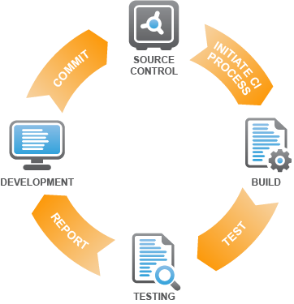
What is CI and what are its principles?
Its main aim is to prevent integration problems, referred to as "integration hell”
Continuous integration (CI) is the practice, in software engineering, of merging all developer working copies with a shared mainline several times a day
It was first named and proposed as part of extreme programming (XP)
Principles
Maintain a code repository
Automate the build
Make the build self-testing
Keep the build fast
Make it easy to get the latest deliverables
Everyone can see the results of the latest build
Automate deployment

Slide 3
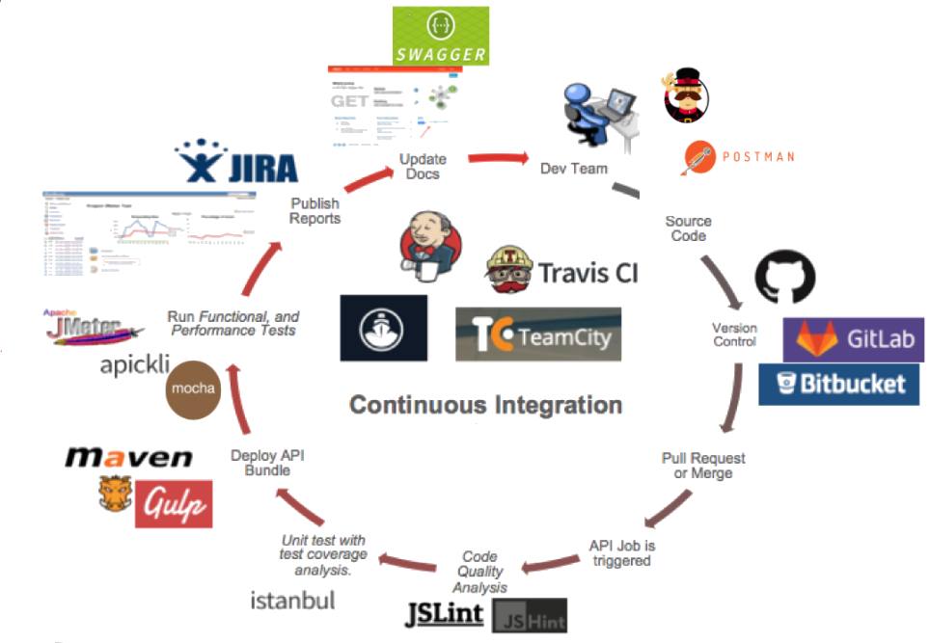
Virtuous CI Cycle for API Proxies

Slide 4
Benefits/Advantages
When unit tests fail or a bug emerges, developers might revert the codebase to a bug-free state
Get feedback early:
Developers detect and fix integration problems continuously
Early warning of broken/incompatible code and promotes test automation
Immediate unit testing of all changes
Releasable code. Constant availability of a "current" build for testing, demo, or release purposes
Trust developers to create modular, less complex code
Metrics generated from automated testing and CI. Enables visibility for all team on what’s breaking, passing or weak points e.g. Performance
It’s opinionated, so best practices on branching strategy are encouraged
Meant to accelerate time to market
Others have paved the way already! Netflix, Google, Etsy, Amazon, Paypal…

Slide 5
Challenges/Disadvantages
Initial setup time required (lack of time)
Well-developed test-suite required to achieve automated testing advantages
Company culture
Many teams using CI report that the advantages of CI well outweigh the disadvantages. The effect of finding and fixing integration bugs early in the development process saves both time and money over the lifespan of a project.

Slide 6
THANK YOU

